Slide 1
Collaborative strategic planning for English and Maths
Geoff Barton & Mark Dawes
Download this presentation at www.geoffbarton.co.uk

Slide 2
This session:
1 – What appears to work in English & Maths: the skills and knowledge that make the difference
2 – Discussion
3 – Two case studies
4 – Discussion

Slide 3
What works in English
Geoff Barton

Slide 4
What works in English:
1 – Explicit teaching of English
2 – Teacher modelling of writing
3 – Oral rehearsal of ideas
4 – Sentence variety & connectives
5 – Teach vocabulary

Slide 5
What works in Maths
Mark Dawes

Slide 6
What works in Maths:
1 – A focus on pupils’ mathematical understanding
2 – Excitement/enthusiasm
3 – Using and applying mathematics
4 – Emphasising mathematical talk
5 – Effective use of ICT

Slide 7
Discussion

Slide 8
Case Study: King Edward’s
Geoff Barton

Slide 9
Key elements for us:
1 – Simple data in the public domain
2 – (Usually) canny identification of ‘key marginals’
3 – Heavy mob intervention
4 – Involving parents and tutors
5 – Focus on the simple stuff: homework, coursework, seating plans, stabilising behaviour, micro- skills
Notes:
Inc coursework catchup, after school detentions

Slide 10
John MacBeath:
Data as “tin-opener”

Slide 11
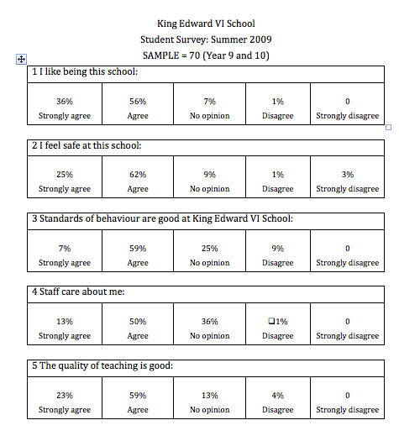

Slide 12
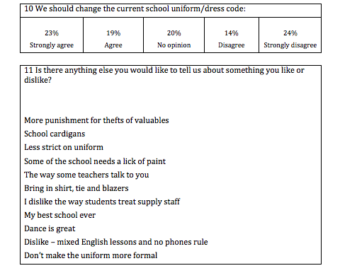

Slide 15
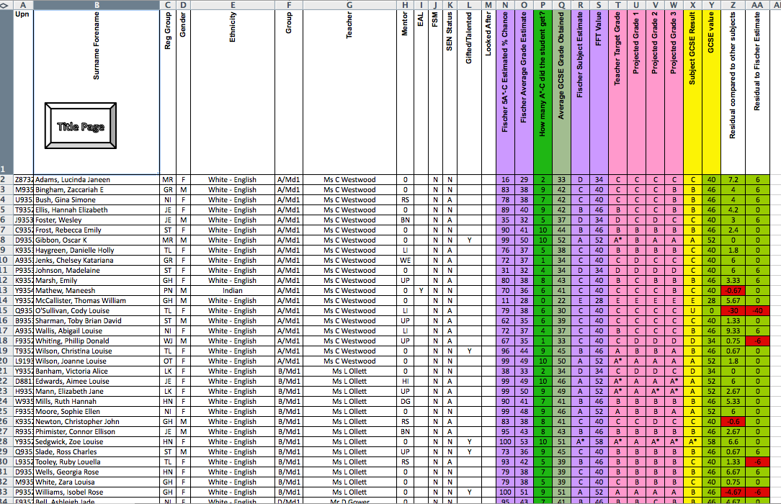

Slide 17
Two “identical” students
Sarah English Level 6
Maths Level 6
Science Level 6
C
D
D
D
D
D
E
James English Level 5
Maths Level 6
Science Level 6
A
A
A
A
A
A
A
B
B
B
C
Notes:
It’s not about if you are a boy or a girl – it’s about YOU

Slide 18
Case Study: Comberton
Mark Dawes

Slide 19
Key elements for us:
1 – KS3 & KS4 have key differences
2 – Group sizes
3 – Careful use of setting
4 – Use of examination sessions
5 – Explicit messages about mathematics
Notes:
Inc coursework catchup, after school detentions

Slide 20
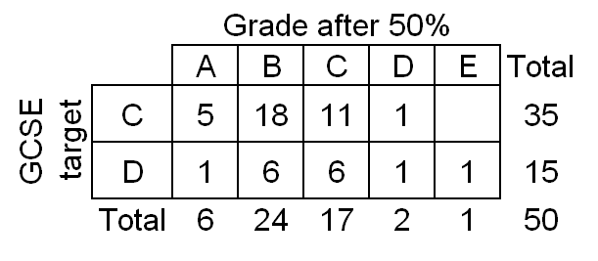
Pupils from the crucial teaching groups

Slide 21
Discussion

Slide 22
Collaborative strategic planning for English and Maths
Geoff Barton & Mark Dawes
Download this presentation at www.geoffbarton.co.uk

